Slide 1
ADDIE PRESENTATION
LORI REYNOLDS
MARCH 12, 2013

Slide 2
Thematic Unit

Slide 3
CHINESE NEW YEAR
Instructional Goal:
Students will participate in class discussions, understand, present, write, and read about the Chinese New Year, Chinese culture and gain an awareness of diversity.
Integrate the following subjects:
Social Studies, Science, Math, ELA

Slide 4
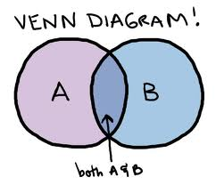
Social Studies
Chinese culture.
Geography (locate China
on a map)
Compare and contrast
American and Chinese cultures.

Slide 5
Science
Basic needs of living things.
*GIANT PANDA
Communicate how the
physical characteristics
help the panda meet its
needs.
Vocabulary: endangered, nature, bamboo, wild

Slide 6
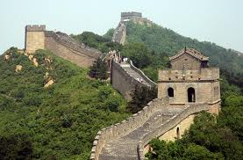
Math
Collect, and represent and draw conclusions from data.
Strategies for keeping track of what has been counted. (length of classroom Great Wall)
Measurement with inches
and centimeters.

Slide 7
English Language Arts
Write informative/explanatory texts about the experiences that they had during the unit. (Facts and opinions)
Read on-level text with purpose and understanding.
Present to the class the project they worked on in small groups. Chinese Zodiac calendar and their animals. (monkey or rooster)

Slide 8
ANALYSIS

Slide 9
What I learned:
This phase is the most neglected aspect.
It is time consuming, but we should never “assume” anything about our learners.
Example: Kali/Cultural
For me, it was where I realized that I really need to know the present level of knowledge of my students, so I know what direction to lead them as learners. I do it consistently in math, but not all subject areas.
Look ahead to the BIG PICTURE!

Slide 10
DESIGN
Instructional Goal:
Students will participate in class discussions, understand, present, write, and read about the Chinese New Year, Chinese culture and gain an awareness of diversity.
Objectives:
Math and ELA came from the common core standards and Science and Social Studies from Utah Core Standards.

Slide 11
What I learned:
The design process is the nucleus of the ISD approach, and MOST IMPORTANT!
Plays a role in all of the other elements, and everything flows through design at some point.
Lesson plans, writing objectives and evaluation tasks are a few of the general functions within design.

Slide 12
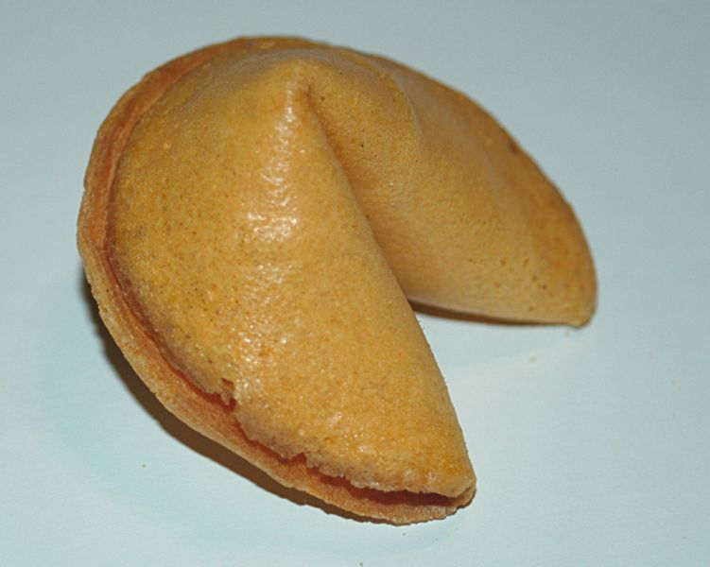
DEVELOPMENT
Hand- outs
PowerPoint
Maps
Computers
Folders/Culture Trunks
Chopsticks, food
Red Envelopes
Chinese Candy
Fortune Cookies
Story book

Slide 13
What I learned:
This phase allowed to me evaluate my materials in an in-depth way, deciding if they were relevant to meeting my objectives. (No “busy” work allowed!)
Everything I worked hard on gathering came together in development.
I was busy during this phase, and found it to be very rewarding. I enjoyed getting everything ready and it felt good to be so organized.

Slide 14
IMPLEMENTATION
Students meet the instruction. (GO TIME!)
All basics are covered, changes have been made or revised if necessary.
Feedback – Did you like it? What was your favorite? What didn’t you like? Did you like the way we did things? Etc…

Slide 15
What I learned:
Most recognizable element in the ISD process.
My opinion: I can’t imagine just being the designer and never see the implementation process. I think that is where teachers get a lot of their satisfaction. Actually “seeing” the lessons implemented.
Kirkpatrick’s Levels of Evaluation:
Level 1 – Reaction (smile sheets)
Level 2 – Learning (tied directly to objectives)

Slide 16
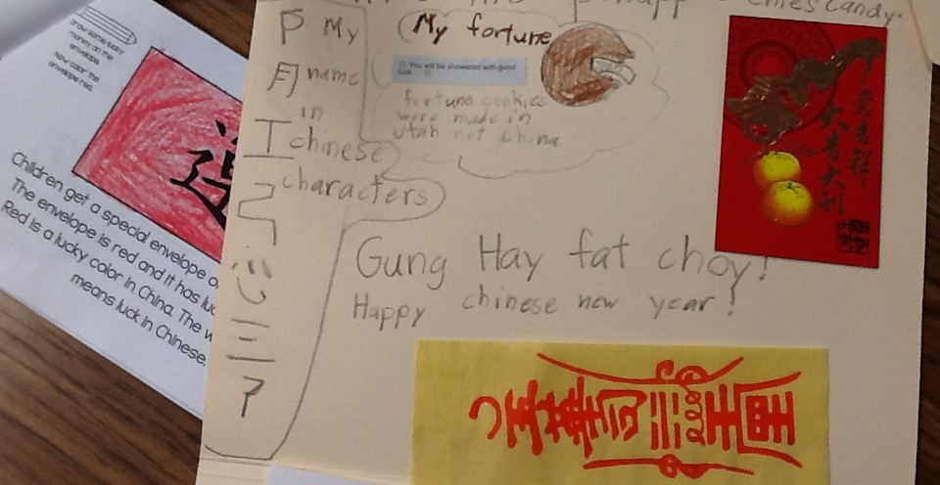
EVALUATION
Culture Trunk, Informational Book

Slide 17
EVALUATION
ELA- Final Journal Entry Personal Narrative
Social Studies – Cumulative Multiple Choice Test on Chinese New Year
SCIENCE
Panda Facts
&
Label Picture

Slide 18
What I learned:
More than just a post test.
Takes place in every element of ADDIE.
Kirkpatrick’s Levels:
Level 3 – Behavior (did it stick?)
Level 4 – Results (what was accomplished?)
ADDE
MODEL
*Just in case you were wondering what the Kirkpatrick fellow looks like. That’s him on the left. Son Jim on the right. Nice to have a face with the name huh? ☺

Slide 19
SERIOUSLY THOUGH…Did I “really” learn anything?
I sure did…
This was quite a process. Daunting at first, and a little bit of WHAT? We have to do this, and that? And A LOT of the other? ☺
*Made me think – teaching, student’s perspective
*Teaching with the end in mind, goals and objectives
*Not teaching “just to teach”

Slide 20
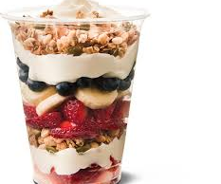
ADDIE MODEL = Parfait
HEALTHY PROJECTS
LOTS OF LAYERS
Students are the consumers
Every layer is a new phase of the ADDIE model
End Result..
After they finish all of the parfait, we want them “full” of relevant and applicable knowledge!

